Slide 1
Cloudathon Pitch Deck
Demo Day
Process Hunters
User Inefficiency on New Enterprise systems

Slide 2

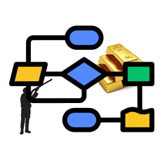
The Team
Process hunting by Mining Gold in Log files
Dolev Kaplan
Deepa C K
Anup Rathnakara Shetty

Slide 3

The Problem
Large Enterprise systems
Enterprise systems implementations, like HDS platform, are often accompanied by changes in the business processes of the organizations in which they take place.
Inefficient Performance
Not all the changes are desirable. Newly operational business process requires many additional steps as “workarounds” of the system limitations and is hence performed in an inefficient manner.
Leveraging process mining
Inefficiencies are reflected in the event log of the system as recurring patterns of log entries.
Once identified, they can be resolved over time by modifications to the enterprise system and presented as “Hints” on the UI.
Objective Solution
We propose an approach for identifying inefficient workarounds by mining the related patterns in an event log.

Slide 4
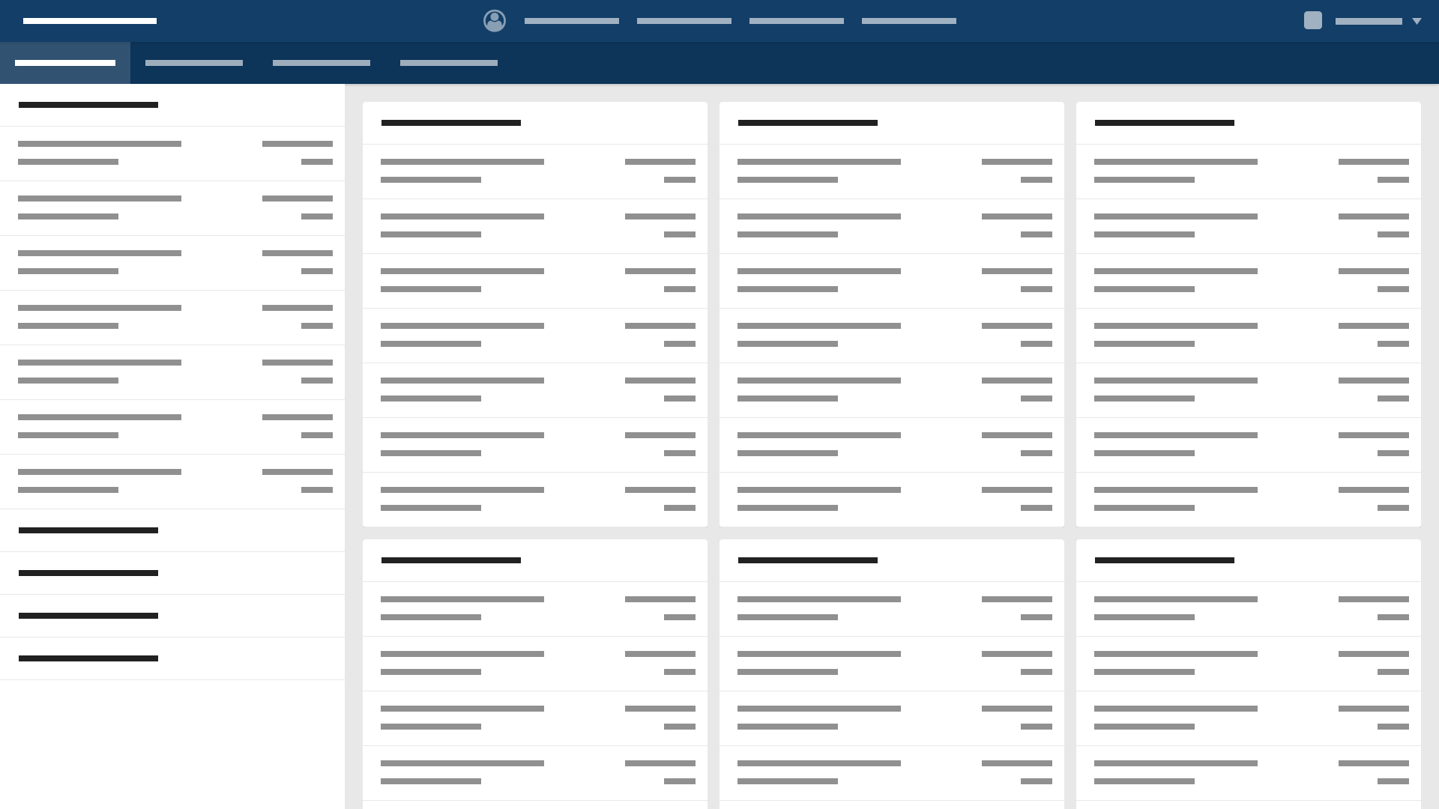
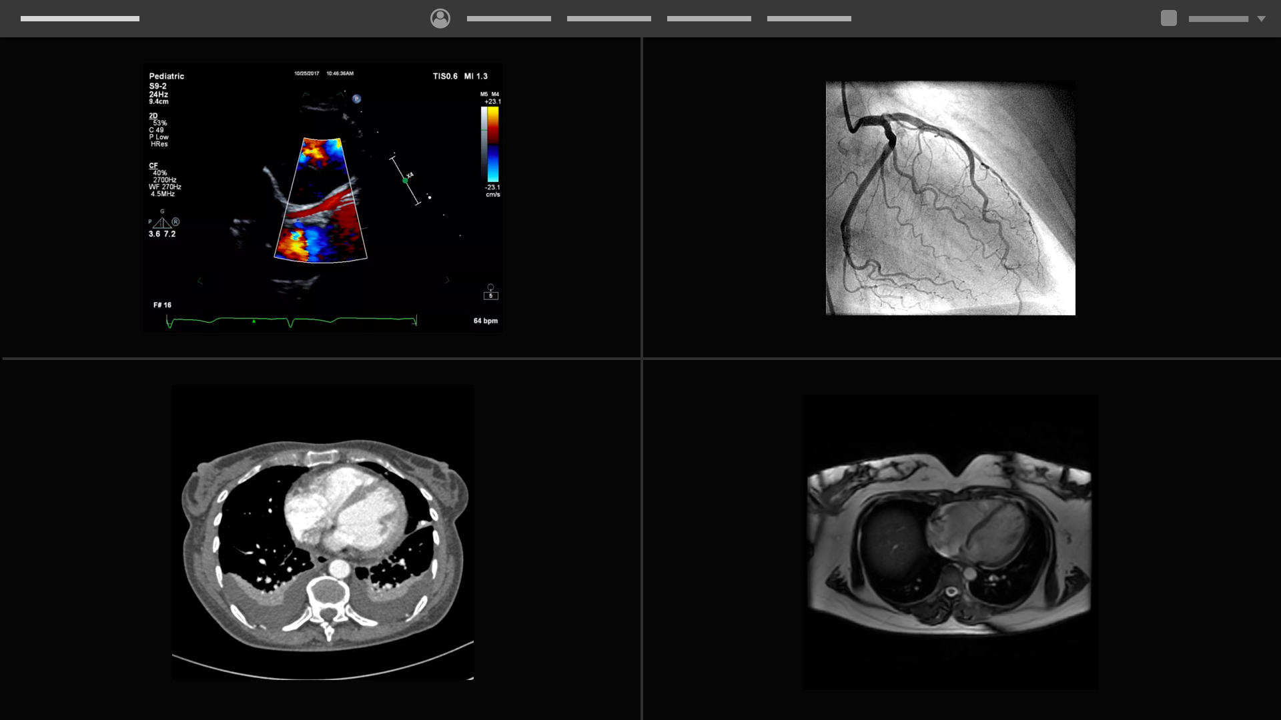
The Solution
Objective Problem Analyses:
Process mining addresses the problem that most of system admins have partial information about what is truly happening, we propose a process mining algorithm for identifying user activities, classifying it as a workflow.
Identify Efficient User flow:
The algorithm compare the workflow of system users to identify inefficiency.
Once inefficiency in a flow was objectively identified by analyzing user’s logs, the system shall presents hints on the UI for users to adopt the most efficient way of work.
Dashboard
Review high level patient information
Trending
Review patient information trending, draw conclusions and correlations
Viewing
Depending on interest deep-dive into individual studies or read reports
Pathways
Document patient diagnostics and treament progression
Worklist
Select patient from patient list
Login
Worklist
Select patient from patient list
Pathways
Document patient diagnostics and treament progression
Viewing
Depending on interest deep-dive into individual studies or read reports

Slide 5




How it Works?
Algorithm Implementation: https://github.com/anuprshetty/UserInefficiencyTracker/blob/main/README.md
Industry Tools: Filebeat, ELK, Kibana APIs and Python code.
The Algorithm classify all log entries as belonging to the same flow and draw general indications for the existence of a pattern.
All the entries are performed by the same user and within a limited time frame.
The maximal time frame for pattern identification can be given as a parameter to an automated application which will identify patterns in a system log.
The entries have at least one parameter whose value is fixed - invariant of the pattern.
The entries have at least one parameter whose value is different for different entries - the variant set of the pattern.

Slide 6
How it Works? – Deep Dive
Mandatory log trace components:
User – A field in the log entry that indicates who made the commit of the event .
Timestamp – The time the log entry was committed.
Operation – The type of activity (transaction) that was performed.
Operand – In a log file entry an operand is a pointer to an object or a pointer to a parameter value of the function
TimeFrame – Delta of timestamps that are used to set pattern start and end entry. TimeFrame [(end entry).timestamp - (start entry).timestamp]
For defining a pattern, we rely on the following assumption: Each log file entry has all the needed operands to perform the event transaction.
The algorithm verifies that the entries have the same user and fall within the predetermined timeframe.
Goes through their operations and list of operands, compares their values, and classifies them as variant or invariant.
If there is at least one variant and at least one invariant, the algorithm returns the pattern (specified as a combined entry).
Entries that were recognized as patterns will be considered as a single entry for the next iteration of recurrence.

Slide 7
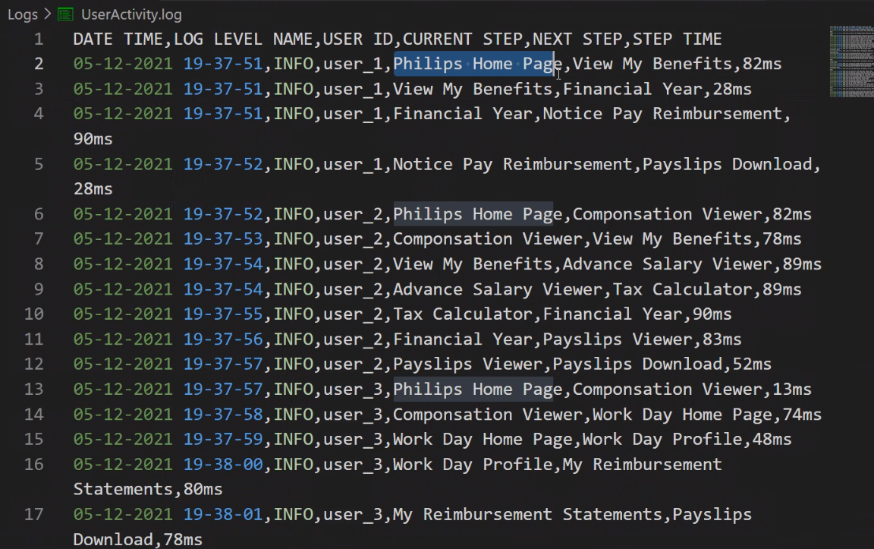
The Value/Benefits
Major reduction of user action duration by increasing user efficiency.
Cost reduction by improve of the system from usability perspective.
Objective identification for “real” needs of the customer – efficient prioritization of new features.
Demo

Slide 8
The Next Steps
Definition of commonality for logs pattern and structure across all components/application/propositions of the HDS platform.
Implementation of the suggested algorithm on Case Studies for known process / workflows.
Definition of new HDS Tool / ELK Capability and develop Hint support on applications UI with UX team.
Patent the algorithm.

Slide 9

Deliverables on the demo Day.
Solution pitch deck
Recorded demo.
Demo day show case on <Date to be finalized>
Notes:
Extra points: submission on time, by Friday 14pm

